Slide 1
Name of Project:MKSP-NTFP-Annapurna ½ acre crop model
Name of PIA: Jattu Trust
Intervention state: Andhrapradesh
Intervention district/(s): Vizianagaram
No. of Intervention Mandals (Plan):6
No. of intervention villages:150
Total Project cost (3years):5.61 crores
No. of Mahila Kisan to be covered (3years):3000
No. of Mahila Kisan covered at the end of current quarter (1st quarter) 1463
No. of SC Mahila Kisan covered 68
No. of ST Mahila Kisan covered: 1322
No. of Minority Mahila Kisan covered: 0
Others: 73

Slide 2
Community institution architecture proposed for MKSP…
 | Generic women institutions | Livelihoods based institutions | Interface/Coordination mechanism | Activities undertaken by LH institutions
Village Level | SHGs | 150 Annapurna pantala Sangams | CRP organize weekly meetings at village level | Promotes Annapurna crop models. Build capacities on pre and post harvesting techniques and Collects village level produces
GP level
Cluster Level | Vos | 8 Cluster Federations | Para professional (cluster cordinator)co-ordinate Cluster Federations | Promotes value addition activities, processing and marketing. Conduct trainings, Mapping resources, planning procurement
Block level
District Level |  | 1 MACS | Project manager/Senior professional co-ordinate MACS . | Promotes value addition activities, processing and marketing. Conduct trainings, Mapping resources, planning procurement , handling greviences and documentation of best practices and co-ordinate all 8 cluster federations.
State Level

Slide 3
Physical progress- SA/NTFP
Particulars | Target as per sanction order/DPR | Target for the given FY | Cumulative achievement till last reporting quarter | Achievement in the current quarter | Plan for the next quarter
No. of Mahila Kisan covered-SA/NTFP activities | 3000 | 1500 | 1463 | - | 537
No. of Mahila Kisan in NRLM compliant SHGs | 3000 | 1500 | 1463 |  | 537
No. of trainee days completed on SA/NTFP for Mahila Kisan | 9000 | 4500 | 3552 |  | 2448
No. of Producer groups formed | 150 | 50 | 70Village level,7Cluster level |  | 20
No. of Mahila Kisan in the fold of PGs | 3000 | 1500 | 1463 |  | 537
Total No. of HHs adopting SA/NTFP practices | 3000 | 1500 | 1463 |  | 537
No. of training modules developed-SA/NTFP
Print | 4 |  | 3 | _ | _
AV | 4 |  | 2 |  | 1
No. of training modules used for training-SA/NTFP
Print | 4 |  | 3
AV | 4 |  | 2

Slide 4
Physical progress-CRP creation-SA/NTFP/Livestock activities
Particulars | Total Target as per sanction order/DPR | Target for the given FY | Cumulative achievement till last reporting quarter | Achievement in the current quarter | Plan for the next quarter
No. of CRPs identified | 500 | 300 | 85 |  | 80
No. of CRPs trained and deployed | 30 |  | 24 |  | 6
No. of training modules developed for CRP training
Print | 4 |  | 3
AV | 4 |  | 2
No. of trainee days of training for CRPs | 180 |  | 144 |  | 36

Slide 5
MKSP Progress
 | Target as per sanction order/DPR | Target for the given FY | Cumulative achievement till last reporting quarter | Achievement in the current quarter | Plan for the next quarter
Net cropped area (Acres) under SA for Kharif season crops | 3000 | 1500 | 1463 |  | 537
Net cropped area (Acres) under SA practices for Rabi crops | 3000 | 1500 | 1463 |  | 537

Slide 6
Output measurement…
Parameters | Status as per baseline | Current status | % increase over baseline
Total volume of Major crop-output/NTFP (Major product) produced (quintals) | Practised only mono cropping. 40% of fields remaining were barren lands | Practicing mixed crops | 100%
Gross output of agri-intervention (Major Crop) only/NTFP activity (in Rs. Lakhs) | - | -
No. of crops /NTFP produce marketed through collective marketing |  | 1 | Only lemon grass marketed through collective marketing. Remarks : ½ Acre Annapurna crop model objective is improve food security among families
No. of Mahila Kisan benefited through collective marketing | 3000 | 30 | Gained food security among them

Slide 7
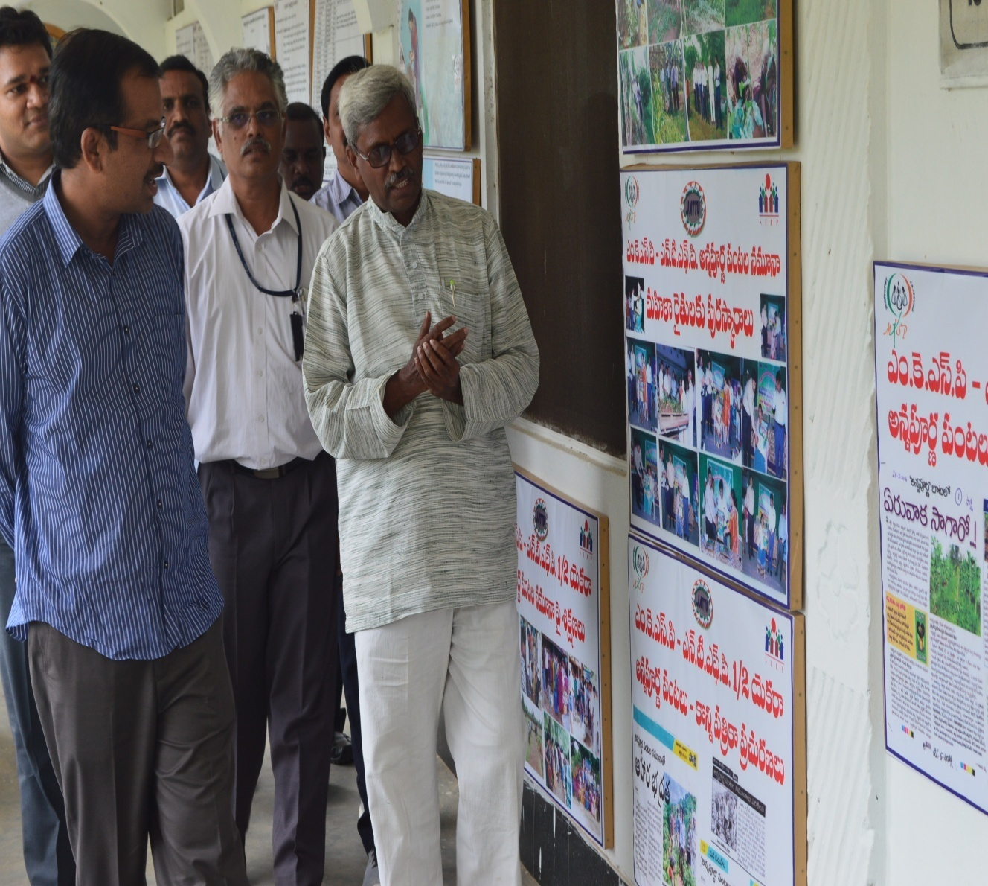
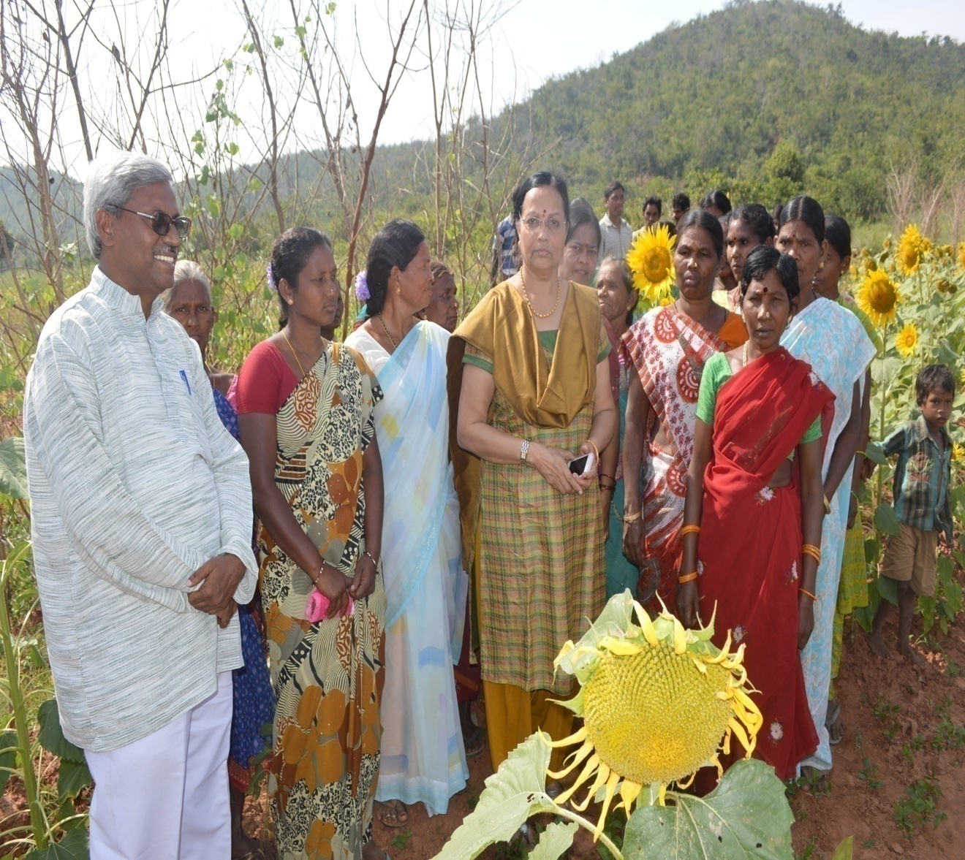
District collector Sri MM Nayak IAS Visiting public disclosures in Jattu Trust office

Slide 8
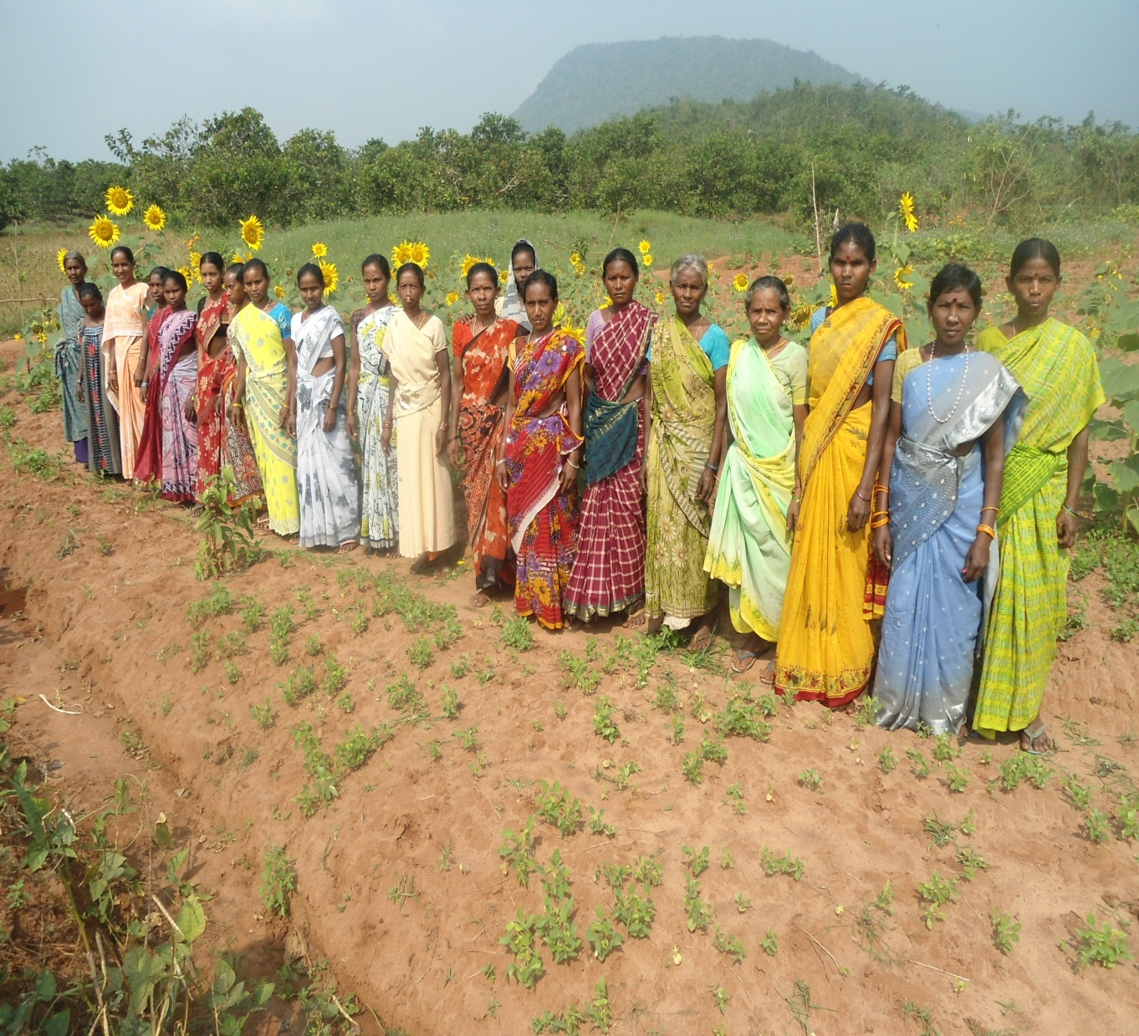
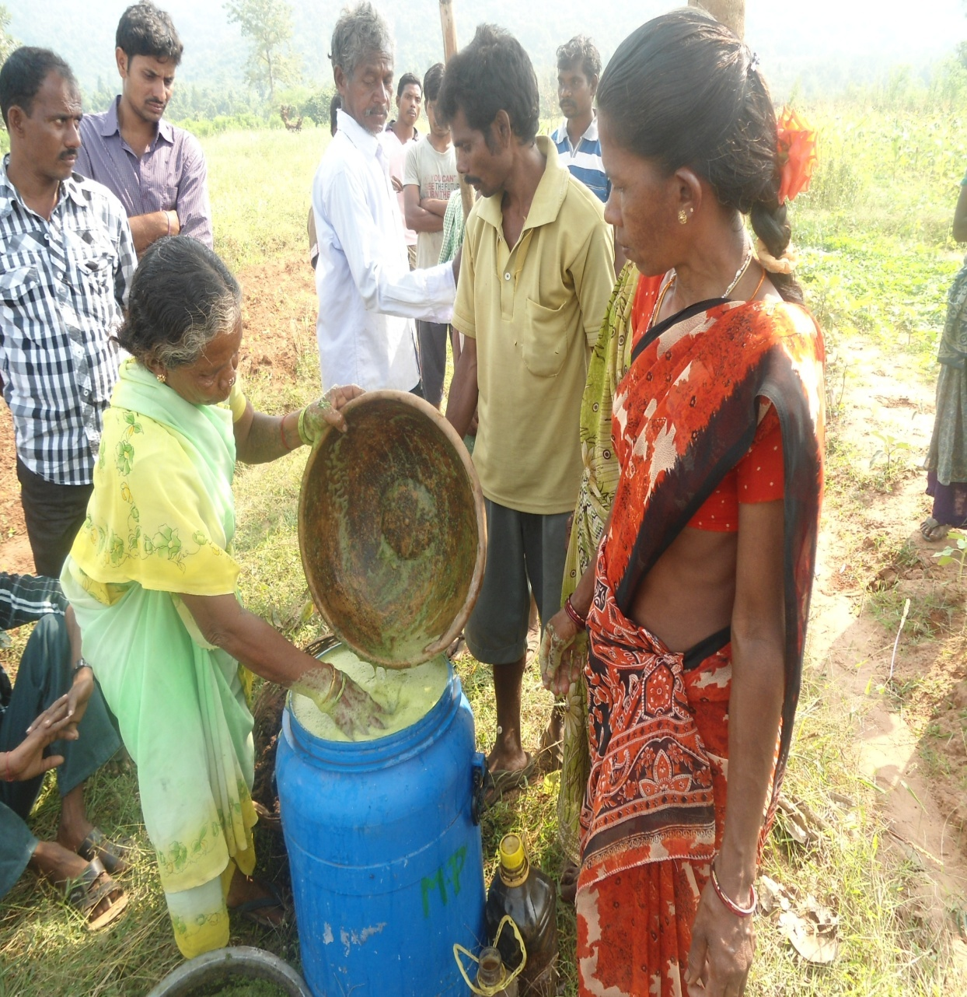
Annapurna Pantala sangam Producer group at Village level

Slide 9
Physical progress-Livestock activities
Total No. of Mahila Kisan covered till date: 1463
Total no. of HHs covered till date:1463
Total No. of Producer Groups formed:70
Total No. of Para professionals trained and deployed at village level:30
All cumulative figures required here

Slide 10
 | Target as per sanction order/DPR | Target for the given FY | Cumulative achievement till last reporting quarter | Achievement in the current quarter | Plan for the next quarter
No. of Mahila Kisan trained on Livestock activities |  |  | 50
Total no. of Producer groups
No. of training modules developed-Livestock activities
Print
AV
No. of trainee days for Mahila Kisan
 | Target as per sanction order/DPR | Target for given FY | Cumulative achievement till last reporting quarter | Achievement in the current quarter | Plan for the next quarter
No. of Para-professionals identified at village level
No. of Para-Professionals trained and deployed at village level | -No-
No. of training modules developed
Print
AV
No. of trainee days for Para-professionals

Slide 11
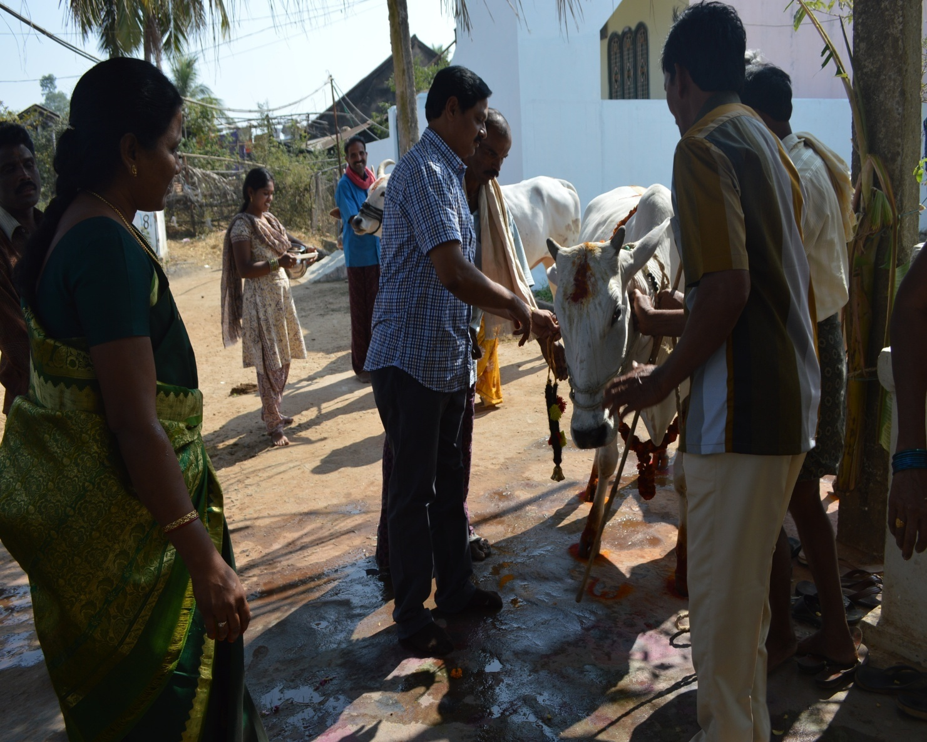
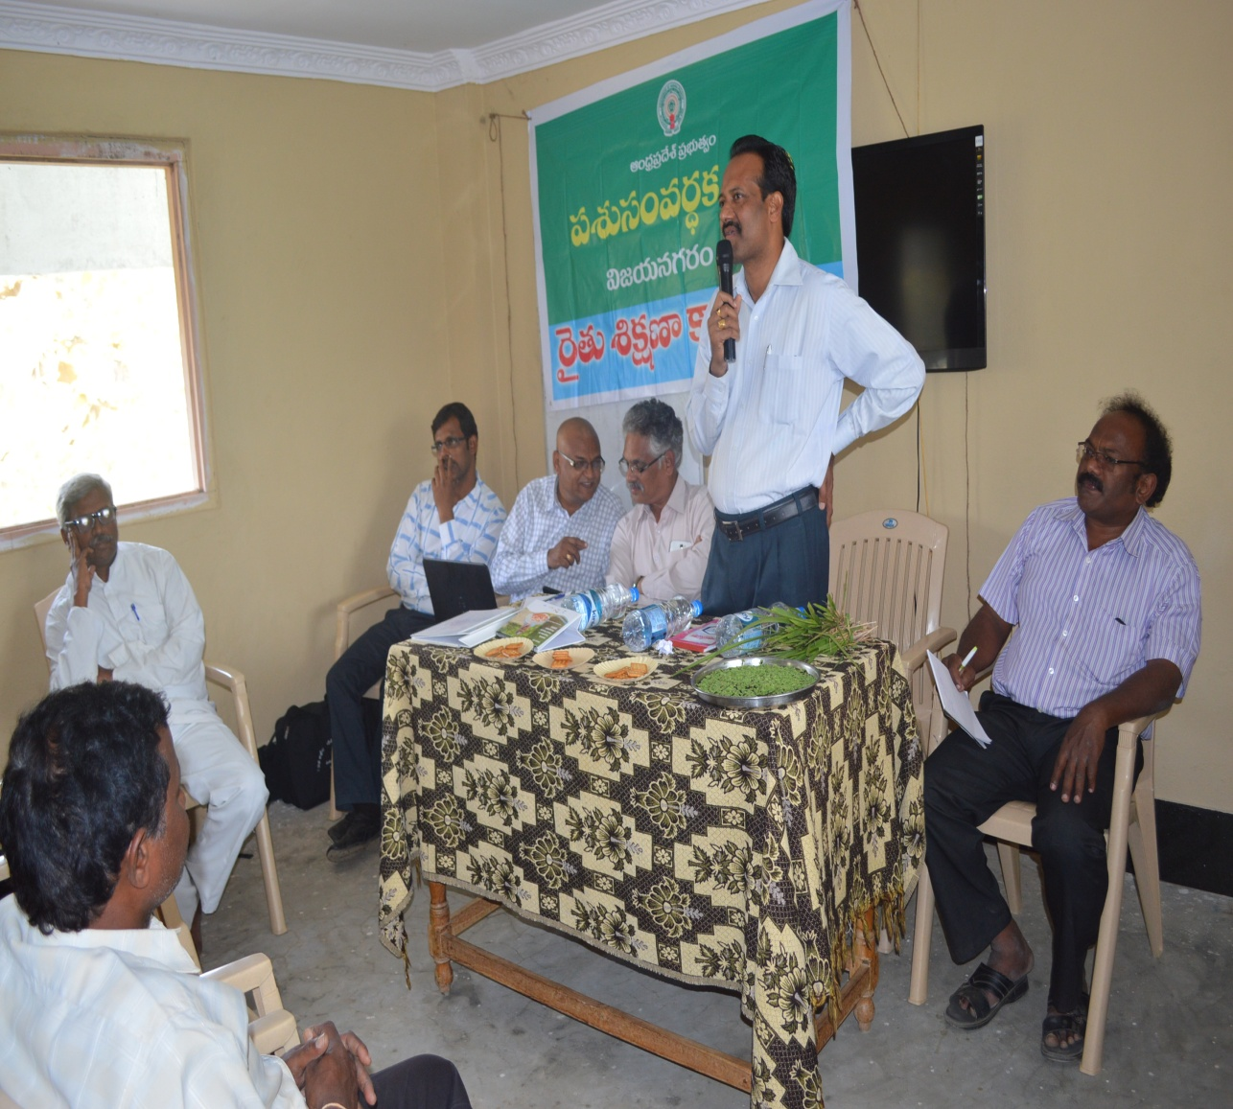
Gomata Poojotsav in Jattu Trust office

Slide 12
Financial Progress

Slide 13
Financial summary Total Sanctioned amount: 5.61 crores Total period of Project:
 | Total amount received till March 2014 | Expenditure till March 2014 | Closing Balance (as on 31st March 2014) | Opening balance (on the first day of current quarter) | Receipts in the current quarter | Expenditure in the current quarter | Closing Balance (as on the last day of current quarter) June 2015
Central share | 7786750 | 8223772 | 360003 (with bank intrest) | 28777 With bank interest | 1693480 | 1693480 | 28714
State share | 772700
Beneficiary contribution
PIA contribution
Others(Interest) | 24870
Total | 8584320 | 8223772 | 360003 | 28777 | 1693480 | 1693480 | 28714

Slide 14
Detailed Financial Summary…As on Dt 30.06.2015
Particulars | Total Approved project allocation (INR) (X) | Cumulative expenditure till last reporting quarter (A) | Expenditure in the current reporting quarter (B) | Total Expenditure till now (T=A+B) | % of Total allocation P= (T/X)*100 | Plan for the Next quarter
Project Inception | 150000 | 101970 | 34300 | 136270 | 91%
Institution Building | 100000
Capacity Building | 14563200 | 4040926 | 473765 | 4514691 | 31%
Community Investment Support | 34400000 | 4729372 | 800000 | 5529372 | 16%
Knowledge Management | 3105640 | 296275 | 28000 | 324275 | 10%
Monitoring & Evaluation | 1115000 | 497723 | 92500 | 590223 | 53%
Administration | 2671680 | 1190129 | 264915 | 1455044 | 54%
Digital green |  | 80702 |  | 80702
Total | 56105520 | 10937097 | 1693480 | 12630577 | 22%

Slide 15
Details

Slide 16
Training Module Development
Name of the Theme on which module developed | Type of training module | Number/units developed so far
TOT for CRP (grooming) | Annapurna model of agriculture practices | 1
Agriculture | “ and traditional agricultural practices | 1
Gender
Community Institution building | Organization of pantala sanghams. Rolls and responsibilities of office bearers / CRPs / C.Cs / P.M | Included in TOT for CRP module
Training of PECs | Cashew processing and marketing Hill brooms processing and marketing Turmeric processing and marketing | 1
Natural Resource Management
.

Slide 17
Status of training of Mahila Kisan

Slide 18
Name of training module | No. of members trained | mode of training/CB | Total training days | Resource agencies/ Persons who have imparted training
Understanding on Traditional Agriculture and modern agriculture | 1184 | Class room training, field visit, and learning by doing | 3162 | PRPs + CRPs
Natural Agricultural scientists and other Govt Institutions. Working on organic Agriculture | “ | “ | “ | “
Non negotiables in organic agriculture practices. | “ | “ | “ | “
Annapurna model of agriculture practices | “ | “ | “ | “
Total no. of Modules | Total 1184 |  | Total no. of days : 3162

Slide 19
Status of Training of CRPs/PRPs

Slide 20
Name of training module | No. of CRPs/PRPs trained | mode of training/CB | Total training days | Resource agencies/ Persons who have imparted training
Understanding on traditional Agriculture and modern agriculture | 24 | Class room training, field visit, and learning by doing | 144 | Jattu Trust Executive Trustee, PM MKSP
Natural Agricultural scientists and other Govt. institutions working on organic Agriculture | “ | “ | “ | “
Non negotiables in organic Agriculture practices | “ | “ | “ | “
Beneficiaries and Harmful insects | “ | “ | “ | “
Annapurna model of agriculture practices | “ | “ | “ | “
Total no. of Modules; 5 | Total 24 |  | Total no. of days: 144

Slide 21
Status of training of Project Staffs

Slide 22
Name of training module | No. of Project staffs trained | mode of training/CB | Total training days | Resource agencies/ Persons who have imparted training
Traditional and Modern Agriculture | 8 | Class room training, field visit, and learning by doing | 48 | Jattu Trust
Natural Agriculture Scientists and other Departments, Institutions working on organic farming | “ | “ | “ | “
Non negotiables in organic Agriculture | “ | “ | “ | “
Beneficiary and Harmful insects in organic agriculture | “ | “ | “ | “
Annapurna model of Agriculture practices | “ | “ | “ | “
Institution building | “ | “ | “ | “
Annapurna pantala sangham at village level, cluster level and project level | “ | “ | “ | “

Slide 23
Physical asset creation

Slide 24
Physical asset creation
Individual level
Source of Funds | Name of the Asset/ Infrastructure created/ given | Number | Total Value of assets
MKSP and 20% community labour contribution | Trench around the Bunds 1.5 x1 width x depth ,Furrows with seven feet gap ,Fruit plants, Fencing around the bunds | 1463 | 10241000
Community Level
Source of Funds | Name of the Asset/ Infrastructure created/ given | Number | Total Value of assets
MKSP | Water tubs | 608 | 126909
Convergence with agriculture Dept | Oil engines, water carrying pipes and power weedors. | 5 oil engines, 175 pipes, 1Weedor, 1 Grass cutter | 170240
Convergence with Nabard | Solar pump set | 1 | 184348
Total |  |  | 481497

Slide 25
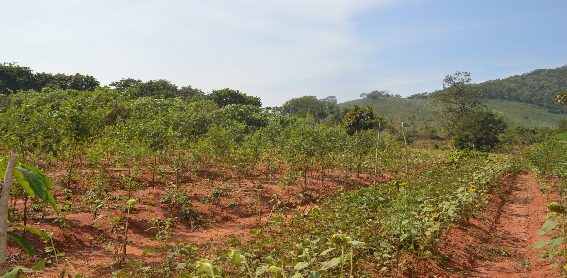
Thanks…

